Slide 1
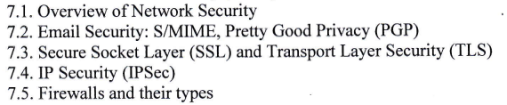
Chapter 7: Network Security

Slide 2
7.1 Overview of Network Security
Network Security
a crucial aspect of information security that focuses on protecting computer networks and their resources from unauthorized access, misuse, disruption, or modification.
It involves implementing various measures to ensure the confidentiality, integrity, and availability of network data and services.
Network security aims to prevent and detect unauthorized access, attacks, and vulnerabilities that may compromise the security of an organization's network infrastructure.

Slide 3
Key components of Network Security
Firewalls
Intrusion Detection System
Virtual Private Networks
Access Control
Network Segmentation
Secure Protocols and Encryption
Network Monitoring and Logging
Security Updates
Network Security Policies
Employee Awareness and Training

Slide 4
Network Security Prevent Against:
Virus
Worms
Trojan
Spyware
Adware
Ransomware

Slide 5
Benefits of Network Security
Reduces overhead expenses and safeguards organizations from costly losses that occur from a data breach or other security incident.
Ensures legitimate access to systems, applications and data enables business operations and delivery of services and products to customers.

Slide 6
How does Network Security Work?
Network security combines multiple layers of defenses at the edge and in the network. Each network security layer implements policies and controls. Authorized users gain access to network resources, but malicious actors are blocked from carrying out exploits and threats.

Slide 7
7.2 Email Security
A critical aspect of network security as email remains one of the most widely used communication channels for businesses and individuals.
Securing email systems involves implementing measures to protect email messages from unauthorized access, interception, tampering, and other forms of threats.
By implementing robust email security measures, organizations can reduce the risk of email-based threats, protect sensitive information, and ensure the integrity of their communication channels.

Slide 8
S/MIME : Secure/Multipurpose Internet Mail Extensions
a widely used standard for securing email messages through encryption and digital signatures.
It provides end-to-end security for email communications, ensuring the confidentiality, integrity, and authenticity of the messages.

Slide 9
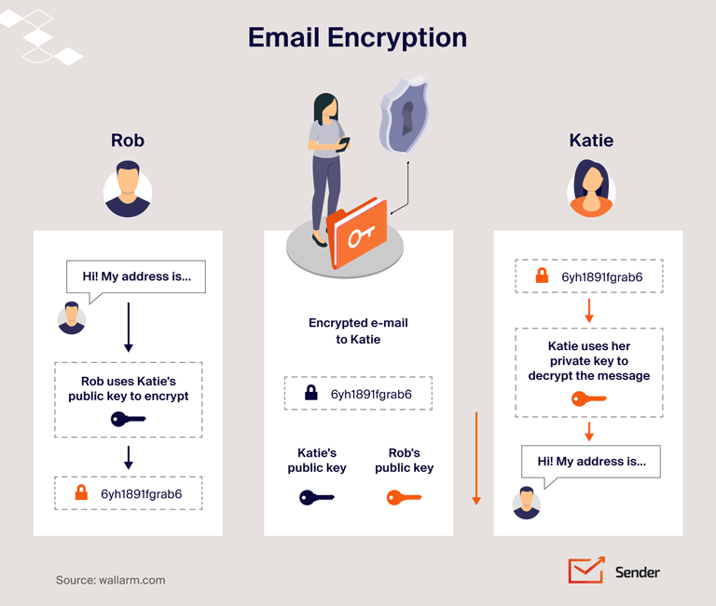

Slide 10
S/MIME : Secure/Multipurpose Internet Mail Extensions
Here’s an overview of S/MIME in email security:
Encryption : S/MIME uses public-key cryptography to encrypt email messages, preventing unauthorized access to the content. Each user has a unique pair of cryptographic keys: a public key for encryption and a private key for decryption. When sending an S/MIME encrypted email, the sender uses the recipient's public key to encrypt the message. Only the recipient, with their corresponding private key, can decrypt and read the message.
Digital Signatures: S/MIME enables the use of digital signatures to verify the authenticity and integrity of email messages. The sender signs the email with their private key, and the recipient can verify the signature using the sender's public key.
Authentication and Identity: S/MIME allows users to verify each other's identities using digital certificates. Digital certificates, issued by trusted Certificate Authorities (CAs), bind an individual's or organization's identity to their public key. S/MIME is supported by most popular email clients and servers, making it widely compatible across different platforms and environments. This allows users to exchange secure email messages regardless of the email software they use, as long as it supports S/MIME.
Interoperability : S/MIME is supported by most popular email clients and servers, making it widely compatible across different platforms and environments.

Slide 11
7. Secure Attachments : S/MIME not only secures the email body but also provides encryption and integrity protection for attachments.
8. Message Integrity : S/MIME protects the integrity of email messages by using digital signatures.
9. Trust Model : S/MIME relies on a trust model based on trusted Certificate Authorities (CAs).
10. Key Management : S/MIME requires the secure management of cryptographic keys. Users must keep their private keys secure and protected with a strong passphrase. Public keys are typically distributed through digital certificates

Slide 12
Pretty Good Privacy (PGP)
a widely used encryption and digital signing technology that provides secure email communication.
Developed by Phil Zimmermann in 1991, PGP has become a standard for securing email messages and other forms of electronic communication.
PGP is an open-source software package that is designed for email security. Phil Zimmerman developed it. It provides the basic or fundamental needs of cryptography.

Slide 13
Overview of PGP in email security
Encryption : PGP uses a hybrid encryption scheme that combines symmetric and asymmetric encryption. When sending an email, PGP generates a random symmetric encryption key for that specific message, encrypts the message using that key, and then encrypts the symmetric key using the recipient's public key. The encrypted message and encrypted symmetric key are sent together.
Digital Signatures: PGP allows users to digitally sign their emails to provide authenticity and integrity.
Web of Trust: PGP operates on a decentralized trust model called the Web of Trust. Instead of relying on a central authority, individuals sign each other's public keys to establish trust.
Key Management: PGP requires the management of public and private keys. Users generate their own key pairs consisting of a public key and a private key.

Slide 14
5. Compatibility: PGP is compatible with various email clients and platforms through plugins or standalone applications. It can be used with popular email clients like Thunderbird, Microsoft Outlook, and Apple Mail, as well as with web-based email services.
6. Additional Features: PGP provides additional features such as key revocation, which allows users to invalidate compromised or lost private keys, and key servers, where users can upload and distribute their public keys for others to access.
7. OpenPGP Standard: PGP's functionality is defined by the OpenPGP standard, which is an open standard managed by the Internet Engineering Task Force (IETF).

Slide 15
Difference between PGP and S/MIME
S.NO | PGP | S/MIME
1. | It is designed for processing plain texts | While it is designed to process email as well as many multimedia files.
3. | PGP is good for personal as well as office use. | While it is good for industrial use.
5. | It depends on user key exchange. | Whereas it relies on a hierarchically valid certificate for key exchange.
6. | PGP is comparatively less convenient. | While it is more convenient than PGP due to the secure transformation of all the applications.
7. | PGP contains 4096 public keys. | While it contains only 1024 public keys.
9. | PGP is also be used in VPNs. | While it is not used in VPNs, it is only used in email services.
10. | PGP uses Diffie hellman digital signature. | While it uses Elgamal digital signature.
12. | PGP is used for Securing text messages only. | S/MIME is used for Securing Messages and attachments.

Slide 16
7.3 SSL and TLS
SSL (Secure Sockets Layer) and TLS (Transport Layer Security) are cryptographic protocols that provide secure communication over networks, particularly over the internet.
They establish an encrypted connection between a client (e.g., a web browser) and a server (e.g., a web server) to ensure the confidentiality and integrity of data transmitted between them.
While SSL was the predecessor, TLS is the newer and more widely adopted protocol.

Slide 17
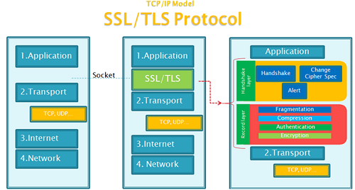

Slide 18
Overview of SSL and TLS:
Encryption: SSL and TLS use encryption algorithms to encrypt data transmitted between the client and server. This ensures that even if intercepted, the data remains secure and unreadable to unauthorized parties. Common encryption algorithms used in SSL/TLS include RSA (Rivest-Shamir-Adleman), AES (Advanced Encryption Standard), and 3DES (Triple Data Encryption Standard).
Handshake: The SSL/TLS handshake process establishes a secure connection between the client and server.
Certificate-based Authentication : SSL/TLS uses digital certificates to authenticate the identities of the server and, optionally, the client.
Versions: SSL and TLS have evolved over time, with multiple versions released. SSL 1.0 and 2.0 are considered insecure and are no longer used. SSL 3.0 improved security but has known vulnerabilities and is also deprecated. TLS 1.0, TLS 1.1, TLS 1.2, and TLS 1.3 are the more recent and widely adopted versions. TLS 1.3 is the latest version and offers improved security, performance, and reduced latency.

Slide 19
5. Usage: SSL/TLS is commonly used in various applications and protocols, including secure web browsing (HTTPS), email transmission (SMTP, IMAP, POP3), virtual private networks (VPNs), and secure file transfer (FTPS).
6. Forward Secrecy: TLS provides forward secrecy (also known as perfect forward secrecy) as an additional security feature. It ensures that even if the long-term private key of the server is compromised, past communications remain secure.
7. Vulnerabilities and Updates: SSL and early versions of TLS have been affected by various security vulnerabilities, such as POODLE, BEAST, and Heartbleed.

Slide 20
7.4 IP Security (IPSec)
a suite of protocols and standards that provides security services for IP (Internet Protocol) network communications.
It is commonly used to secure virtual private networks (VPNs) and ensure the confidentiality, integrity, and authenticity of IP packets transmitted over an IP network.

Slide 21
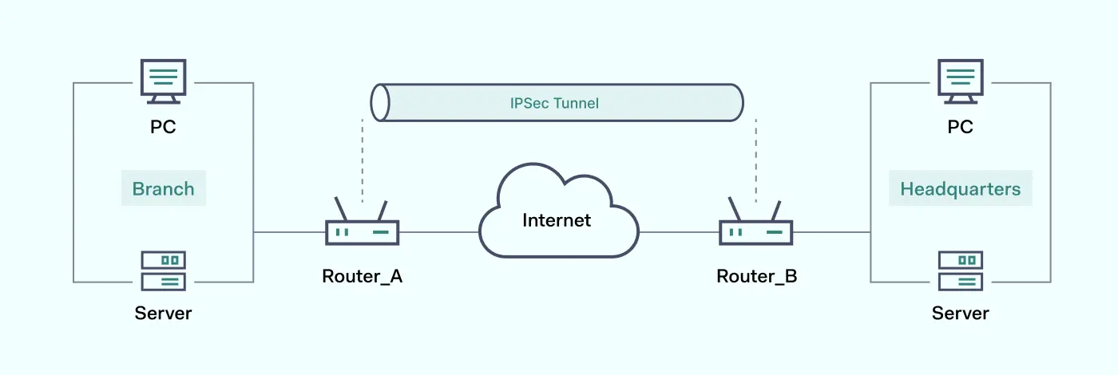

Slide 22
Why is IPSec Important?
The Internet Engineering Task Force developed IPSec in the 1990s to ensure data confidentiality, integrity, and authenticity when accessing public networks.
For example, users connect to the internet with an IPSec virtual private network (VPN) to access company files remotely.
The IPSec protocol encrypts sensitive information to prevent unwanted monitoring. The server can also verify that the received data packets are authorized.

Slide 23
What are the uses of IPSec?
IPsec can be used to do the following:
Provide router security when sending data across the public internet.
Encrypt application data.
Authenticate data quickly if the data originates from a known sender.
Protect network data by setting up encrypted circuits, called IPsec tunnels, that encrypt all data sent between two endpoints.
Organizations use IPSec to protect against replay attacks. A replay attack, or man-in-the-middle attack, is an act of intercepting and altering ongoing transmission by routing data to an intermediary computer.

Slide 24
How does IPSec work?
Computers exchange data with the IPSec protocol through the following steps.
The sender computer determines if the data transmission requires IPSec protection by verifying against its security policy. If it does, the computer initiates secure IPSec transmission with the recipient computer.
Both computers negotiate the requirements to establish a secure connection. This includes mutually agreeing on the encryption, authentication, and other security association (SA) parameters.
The computer sends and receives encrypted data, validating that it came from trusted sources. It performs checks to ensure the underlying content is reliable.
Once the transmission is complete or the session has timed out, the computer ends the IPSec connection.

Slide 25
7.5 Firewalls and their types
Firewalls are network security devices that act as a barrier between an internal network and external networks, such as the internet.
They monitor and control incoming and outgoing network traffic based on predefined security rules.
Firewalls help protect networks from unauthorized access, malicious activities, and potential threats.

Slide 26
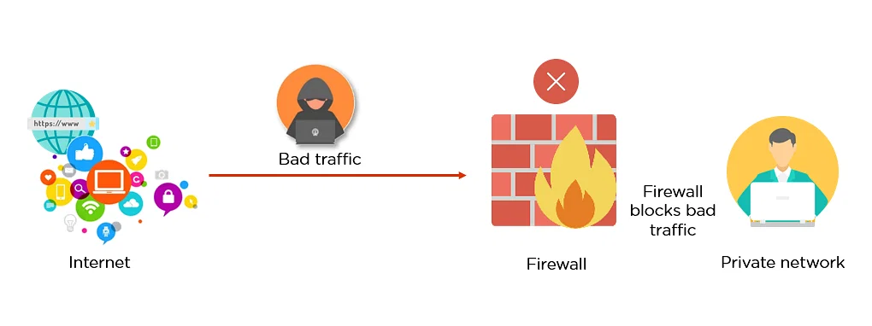

Slide 27
Types of firewall
Packet Filtering Firewalls: A small amount of data is analyzed and distributed according to the filter’s standards.
Stateful Inspection Firewalls: Dynamic packet filtering that monitors active connections to determine which network packets to allow through the Firewall.
Application-Level Gateways (Proxy Firewalls): Network security system that protects while filtering messages at the application layer.
Next-Generation Firewalls (NGFW): Deep packet inspection Firewall with application-level inspection.

Slide 28
Why Do We Need Firewalls?
Firewalls, especially Next Generation Firewalls, focus on blocking malware and application-layer attacks.
Along with an integrated intrusion prevention system (IPS), these Next Generation Firewalls are able to react quickly and seamlessly to detect and combat attacks across the whole network.
Firewalls can act on previously set policies to better protect your network and can carry out quick assessments to detect invasive or suspicious activity, such as malware, and shut it down.
By leveraging a firewall for your security infrastructure, you’re setting up your network with specific policies to allow or block incoming and outgoing traffic.

